Slide 1
Transformers Architecture
Attention is All You Need

Slide 2
Why Transformers.
Let go through some architectures that are commonly used to process sequential data.
1.Recurrent Neural Networks (RNNs).
2. Long Short-Term Memory (LSTM) Networks.

Slide 3
RNN
There are mainly 3 models in RNN
1. Vector-sequence model
Input is a vector and output will be a sequence
2. Sequence-vector model
Input is a sequence and output will be a vector
3. Sequence-sequence model
Input is a sequence and output will be a sequence

Slide 4
Limitations
Slow to train
Cant deal with long sequences well
Vanishing gradient problem will happen when dealing with large sequence of data
Input data needs to pass sequencialy

Slide 5
Long Short-Term Memory (LSTM) Networks
LSTM is even slower for training compared to RNN.
Better than RNN in dealing with long sequence
LSTMs address the vanishing gradient problem in traditional RNNs by incorporating specialized "memory cells" that allow the network to selectively remember or forget information over long time periods
Both RNN and LSTM input data need to put sequentially one after the other, we need input of the previous state to do any operation on current state.
Both serial flow does not make use of GPU very well, which are designed for parallel computation.

Slide 6
Both RNN and LSTM cant understand the context of a word because of word by word processing
Context of the word is so import as the context changes, the meaning also changes.
Ex: There is a word -’ Point’, and we use it in two
different contexts given below
-The needle has a sharp point.
-It is not polite to point at people.

Slide 7
To resolve all these problem there was a need for a different architecture ,
That is Transformer architecture.
The Transformer was proposed in the paper Attention is All You Need.

Slide 8
Transformer
So the question is how can we make use of parallelization on sequential data?
As an answer to this question transformers are introduced in 2017.
A transformer model is based on a self-attention mechanism.
This attention mechanism helps the model to capture long-range dependencies and to avoid the vanishing gradient problem that can occur in recurrent neural networks.
Encoder and Decoder are building blocks of a Transformer.

Slide 9
Transformers architecture allows parallel processing of the input sequence, rather than sequential processing.
This parallel processing approach allows transformers to capture long-range dependencies much more effectively than traditional RNN-based models like LSTMs.

Slide 10
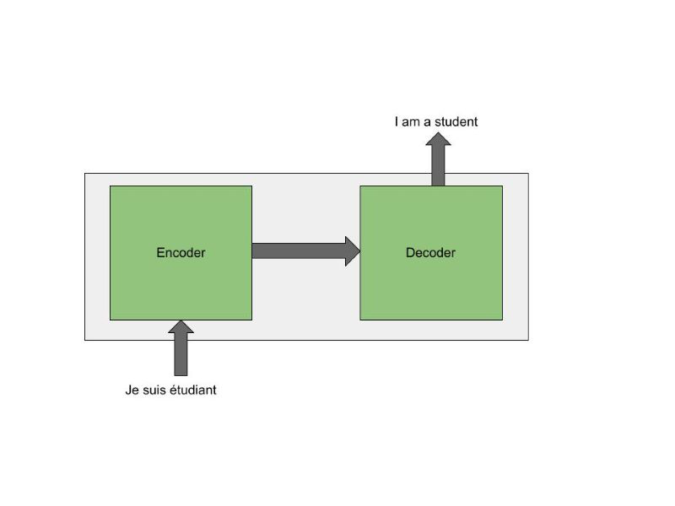
The encoder block turns the sequence of input words into a vector and a Decoder converts a vector into a sequence. Eg: A text in French processed into its English equivalent can be: Je suis étudiant –> I am a student.

Slide 11
Deep in to Transformer Architecture
The encoder architecture has two layers: Self Attention and Feed Forward.
The encoder’s inputs first pass by a self-attention layer and then the outputs of the self-attention layer are fed to a feed-forward neural network.

Slide 12
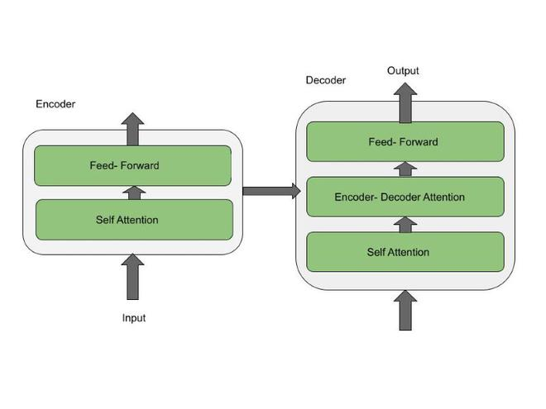

Slide 13
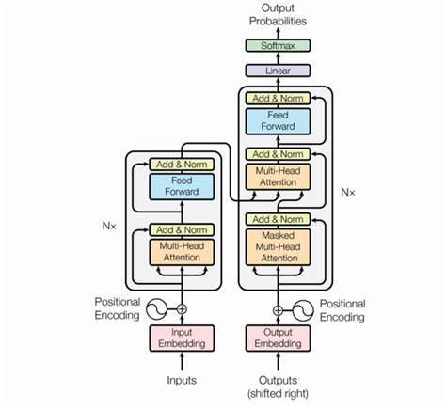
Transformers architecture

Slide 14
Embedding: To represent words in a numerical format, typically vectors.
Positional encoding: Representation of the position of a items in a sequence
same words can have different meaning, that is
where positional encoder comes in
eg: # arun’s dog is a cutie. (2nd position)
#arun look like a dog. (5th position)
After applying word embedding + positional encoding we get word vector that have positional information, i,e context info.
We pass this information to a encoder block where it goes through a multi headed attention layer and feed forward layer.

Slide 15
Attention layer
It involve answering “what part of input should we focus on?”.
The question we want to answer is “ how relevant is the ‘i’th word
in a sentence relevant to another word in the same English sentence.
We use attention vector to capture the relation between words in a
sentence.
Attention block compute attention vector for each word.
Since we use multiple attention vector we call it multi headed attention block.
Each of attention vectors are independent to each other.
We can pass all the words at the same time to encoder block and the out put will be a set of encoded vector for every word.

Slide 16
Decoder
The decoder architecture has three layers: Masked self attention, self Attention, and Feed Forward.
Masked self attention : This layer allows the decoder to attend to all positions up to and including the current position in the output sequence, but not beyond.
The output of the Masked Multi-Head Self-Attention layer is then fed into the Multi-Head Attention layer then the feedforward layer.

